Slide 1
Statistics

Slide 2
Statistics
The science of collecting, organising, summarising, analysing, and interpreting data
Goal:
Use imperfect information (our data) to infer facts, make predictions, and make decisions
Descriptive Statistics:
Summarising data with numbers or pictures
Inferential Statistics:
Making conclusions or decisions based on data

Slide 3
A Static
It is a number or value, in context
It is essential to understand the context
Which data?
How collected?
Or whom?
For what?

Slide 4
Five number summary
Life Expectancy data of the world from UN ; Gapminder
We have data of each country like
Zambia 49.025
How to show this data …

Slide 5
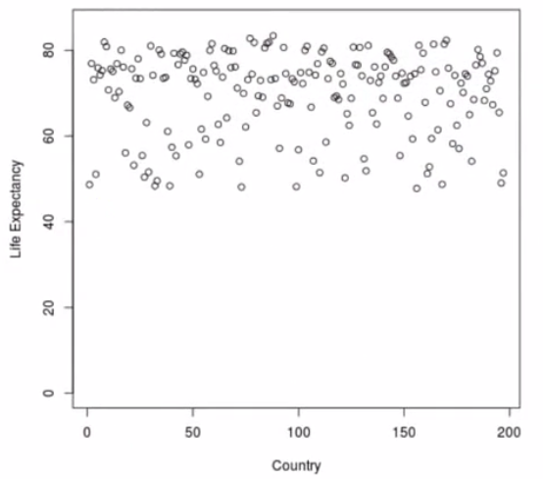
Plot it on Graph A to Z countries

Slide 6
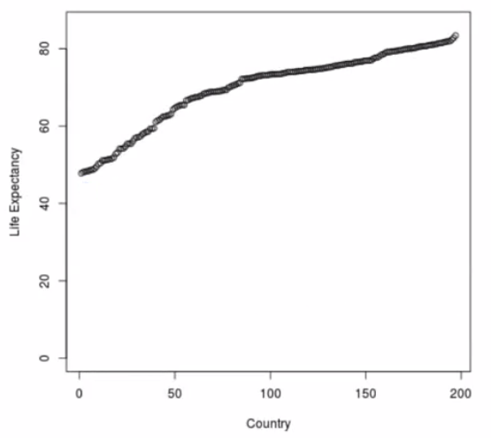
Line Graph

Slide 7
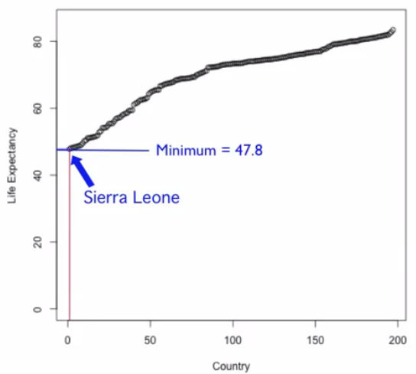

Slide 8
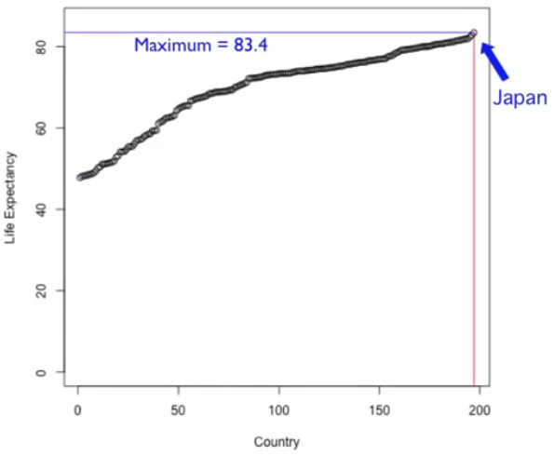

Slide 9
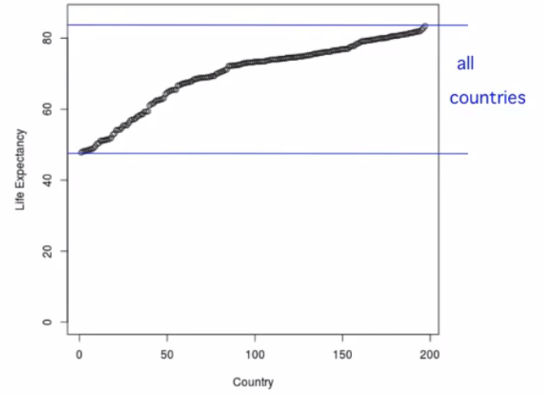

Slide 10
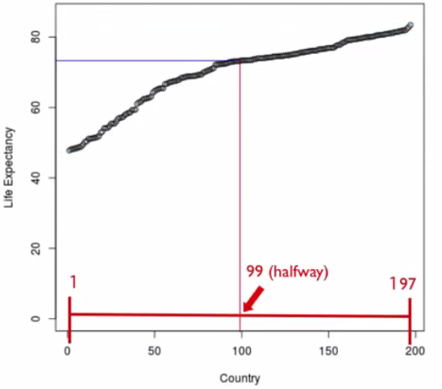

Slide 11
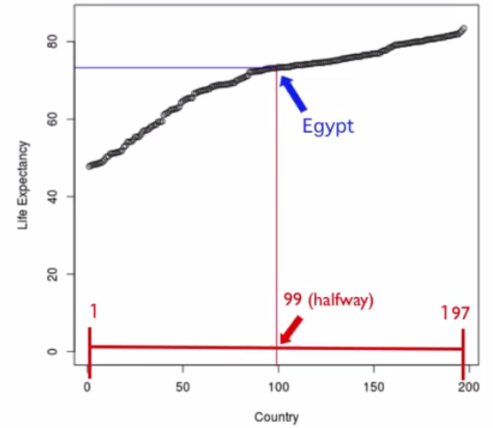

Slide 12
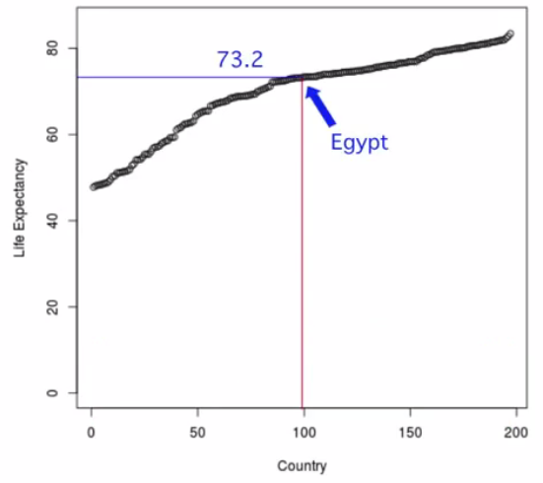

Slide 13
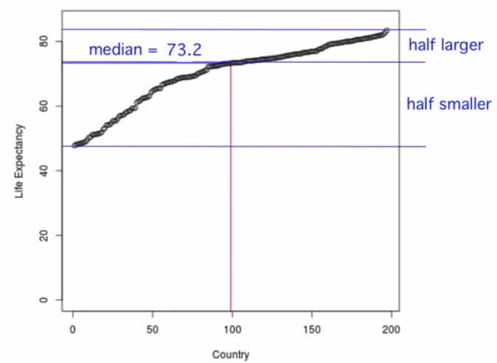

Slide 14
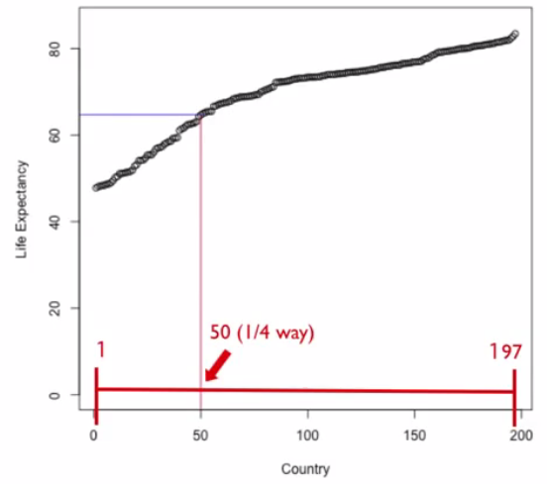

Slide 15
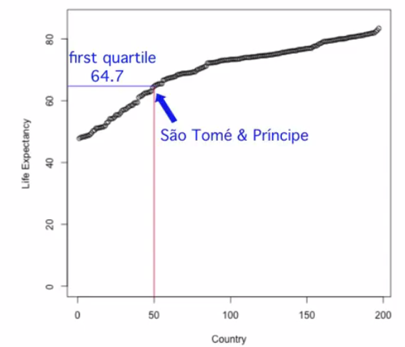

Slide 16
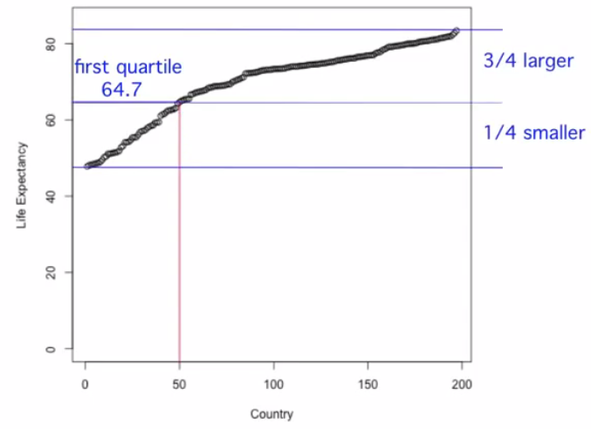

Slide 17
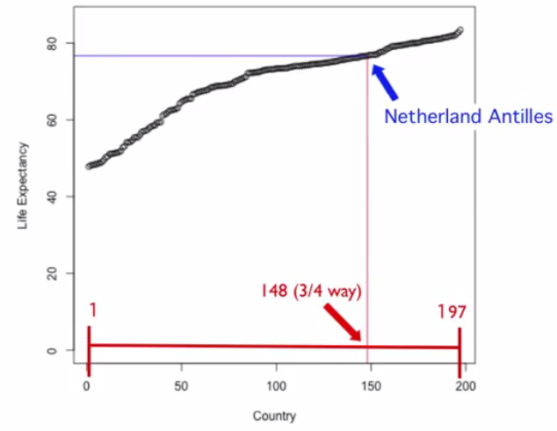

Slide 18
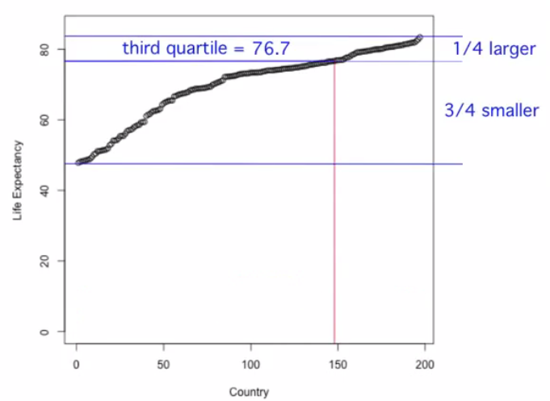

Slide 19
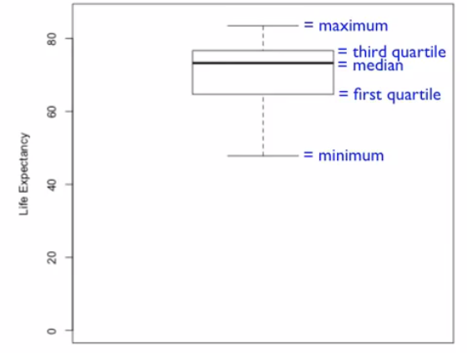
Box Plot

Slide 20

Quiz – Make the Box Plot

Slide 21
The Centre of the Data and the Effects of Extreme Values

Slide 22
Estimated Age – Actual Age from 400 skeletons
Data provided by some anthropologist.
Trying to estimate age at death from skeletal remains.
The age estimation from skeletons is done with the help of Di Ganji et al. ( ) method.

Slide 23
Observation Sex BMI Age DGEst DGDiff
1 2 underweight 78 44 -34
2 1 normal 44 32 -12
3 1 overweight 72 32 -40
4 1 overweight 59 44 -15
5 1 normal 60 32 -28
6 1 underweight 34 25 -9
7 1 overweight 50 32 -18
8 1 underweight 73 50 -23
9 1 normal 70 39 -31
10 1 normal 60 44 -16
11 1 normal 58 32 -26
12 1 overweight 61 32 -29
13 2 overweight 52 44 -8
14 1 normal 67 44 -23
15 1 normal 60 44 -16
16 1 normal 68 50 -18
17 2 overweight 35 12 -23
18 2 obese 81 39 -42
19 2 underweight 73 44 -29
20 1 normal 65 39 -26
21 1 normal 57 57 0
22 2 normal 67 32 -35
23 2 normal 60 44 -16
24 1 normal 35 32 -3
25 1 overweight 64 32 -32
26 1 normal 76 32 -44
27 2 underweight 39 32 -7
28 1 overweight 60 44 -16
29 1 normal 41 61 20
30 1 obese 55 32 -23
31 2 normal 38 57 19
32 1 normal 60 61 1
33 1 normal 70 50 -20
34 1 normal 70 44 -26
35 1 normal 50 44 -6
36 1 overweight 28 25 -3
37 2 underweight 66 44 -22

Slide 24
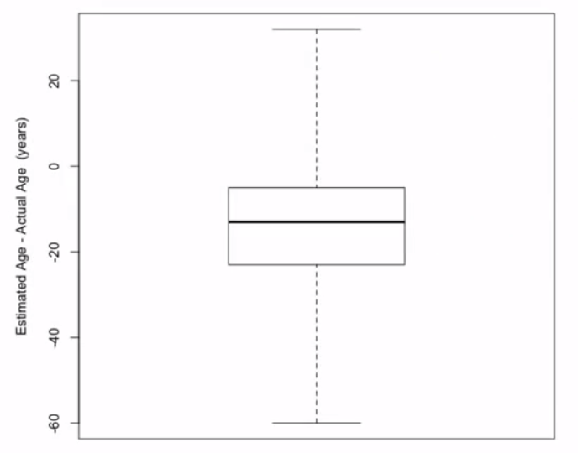
Estimated Age – Actual Age from 400 skeletons

Slide 25
Observations
There are some positive values,
We can see that most of the observations are negative.
In fact, because the third quartile is negative, we know that more than three quarters or 75% of the data are negative.
So, the method of Di Ganji tends to underestimate the age of death.

Slide 26
Observations
It's also possible with this method to be way off from the actual age.
Note that the minimum value is negative 60.
Meaning for one of the observations, the estimate was 60 years younger than the actual age.
We to investigate how unusual this value of negative 60 is!

Slide 27
Five number summary
Min -60
1st Q -23
Median -13
3rd Q -5
Max 32
Calculate Inter Quartile Range (IQR) : -5 – (-23)
= 18
Locate the inner fences, which are designed to contain most of the data.
The inner fences are the values that are 1.5 times the IQR beyond the first and third quartile.
Calculating Lower inner fence: -23 – (1.5 * 18) =-50
Similarly, for the upper inner -5 + (1.5 * 18) = 22

Slide 28
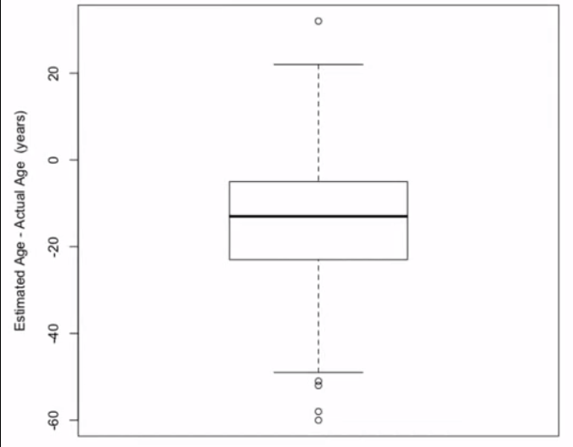
Modified Box Plot

Slide 29
Robust Statistic
Values outside the fences are indicated individually and are worthy of some attention, particularly isolated values that are far outside the fences.
Median 13
Mean 14.2
Mean is not a robust statistic. That is, it is not resistant to extreme observations.
In contrast, the median is a robust statistic. Changing the values of the extreme observations does not change the value of the middle observation.

Slide 30
Summary of construction of a modified box plot
Draw a box from the 1st to 3rd quartiles
Indicate the median with a line in the box
Calculate
Interquartile range (IQR) = 3rd quartile – 1st quartile
Lower inner fence = 1st quartile – 1.5 * IQR
Upper inner fence = 3rd quartile + 1.5 * IQR
The whiskers extend to the largest data value that is less than or equal to the upper inner fence and the smallest data value that is greater than or equal to the inner fence
Data values outside the fences are indicated separately and may be worthy of attention

Slide 31
Trimmed Mean
Suppose we wanted to limit the influence of the extreme observations on the calculation of the mean, one option is to use a trimmed mean.
To find a 10% trimmed mean, delete the largest 10% and the smallest 10% of the data, and then take the average of the remaining observations.
For these data, we remove the 40 largest and smallest data values, and the 10% trimmed mean is negative 13.8.
Note that the trimmed mean is closer to the median than the mean, as the trimmed mean is more robust to extreme observations than the mean.

Slide 32
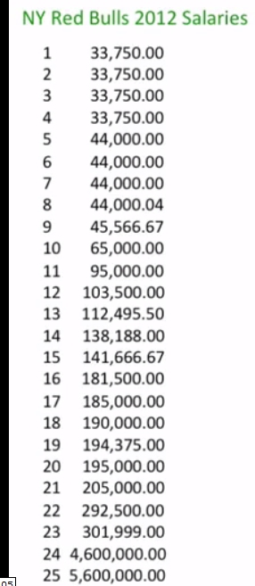
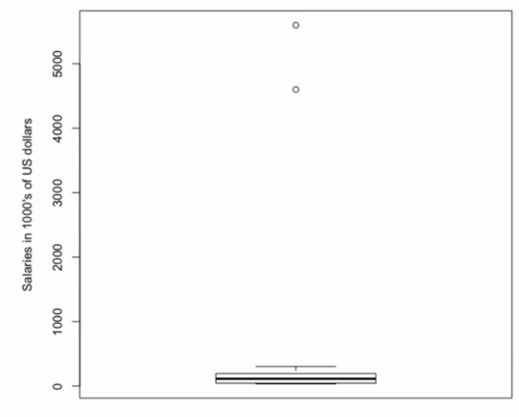
The modified box plot needed to be very compressed to fit 2 extreme values on the screen.

Slide 33
One can see just how unusual two players salaries are by looking at a modified box plot.
Median = 112495.50
Mean = 518311.60
Trimmed mean
8% of 25 = 2; So,
8% trimmed mean (21 players) = 128109.10
Value that is much more representative of the salaries of the rest of the team

Slide 34
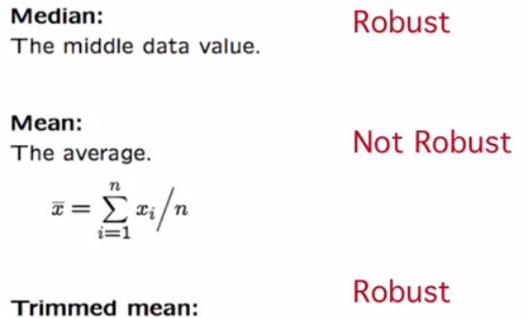
Summary of measures
The a% trimmed mean is the mean of the remaining data values after the k largest and k smallest data values have been removed, where k= (a/100) x n
If k is not an integer, the number of data values to remove from each end of the ordered data is the integer less than k

Slide 35
The Spread of the Data

Slide 36
Spread of Data
How far does it seem to be away from its central value
Median and Mean are two different measures of the location or the central value of the data.
From the example of Life expectancy data, we learned:
Median life expectancy = 73.2 years.
Mean life expectancy = 69.9 years.

Slide 37
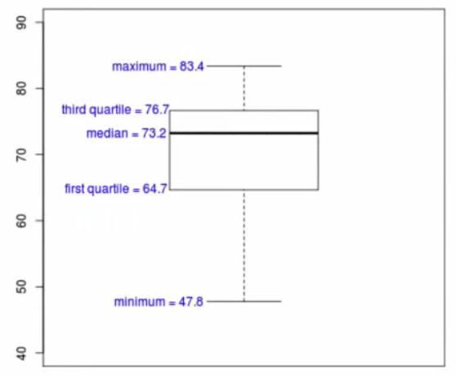

Slide 38
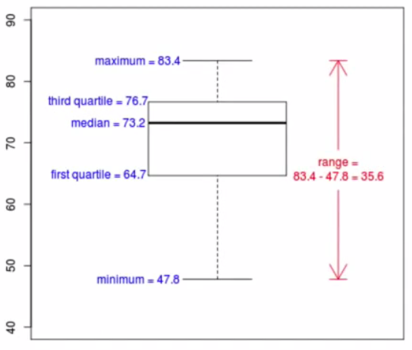
Range

Slide 39
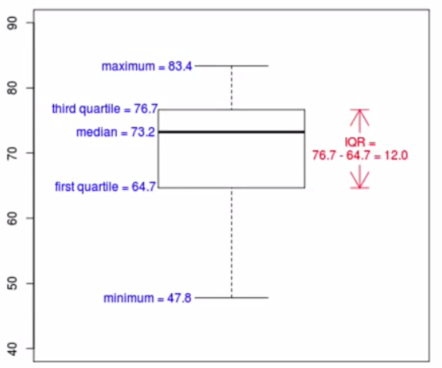
IQR

Slide 40
Deviation
Range and IQR only take into account only two values; not all the value
If we wanted to use all of the deviations of all of the data values from their mean?
We could just try adding up all of the deviations of all of the values from their mean.
Summing up all deviations will give us 0
We could also try adding up the absolute values of all of the deviations of all of the data values.
The best and most useful thing to do is to add up the squares of all of the deviations of all of the data values from their means.

Slide 41
Variance – standard Deviation
Add up the squares of all of the deviations of all of the data values from their means.
We don't really want the sum, we want a sort of an average.
So, divide this by n minus 1
The first value does not tell us anything … rest of n-1 tell us something
If we want to undo all those squares that we did, we can take a big, giant square root.
So, once we take a square root of 1 over n minus 1 times the sum of the square of all the deviations from the mean value, that gives us what's called the standard deviation.

Slide 42
Example
Mean = 80.4
Variance = ((68-80.4)² + (69-80.4) ² + …)/8 = 87.3
Standard Deviation = 9.3

Slide 43
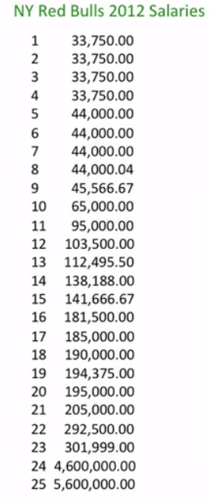
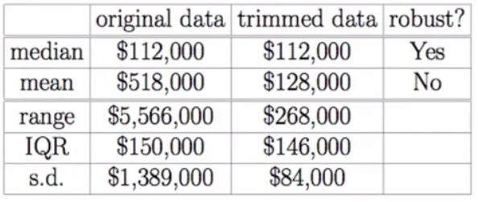
NY Red Bulls 2012 Salaries – Example
No
Yes
No

Slide 44
Shape of Data

Slide 45
Distribution of Data
The pattern of the values of data is called its distribution.
Showing there occurrence relative to each other
We can see whether the data
tend to be close to a particular value, or
maybe multiple values,
whether the data varies a lot or a little about the most common values,
whether that variation tends to be more above or below the common values,
and whether there are unusually large or small values in the data.

Slide 46
Histogram
A histogram is useful for visualizing the distribution
Histogram of life expectancy for the 197 countries and territories for which a 2011 value for life expectancy
The width and number of bins in a histogram can be any convenient value.
However, it is possible to dramatically change the appearance of a histogram with the choice of bin size, particularly when the number of data values is small.
As an example, if we change the bins to cover only a two-year span, the life expectancy histogram appears to be more noisy, with more variation in the frequencies among bins.
We can't tell from the histogram what the exact value of the minimal life expectancy is.

Slide 47
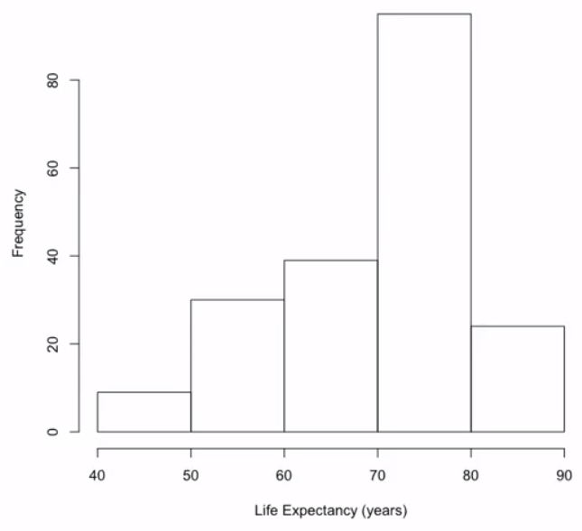
Histogram of life expectancy for the 197 countries and territories for 2011

Slide 48


Histogram
The first step in constructing a histogram is to divide the data values into intervals or bins that are mutually exclusive so that they don't overlap and exhaustive so that we don't miss any of the data.
Bins are usually equal in size, but they don't have to be.
40,50,60,70,80,90

Slide 49
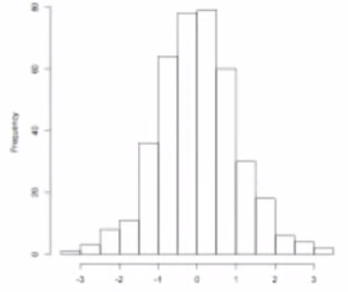
Tails
Life expectancy has a longer left tail than right tail, corresponding to countries or territories with relatively low life expectancies.

Slide 50
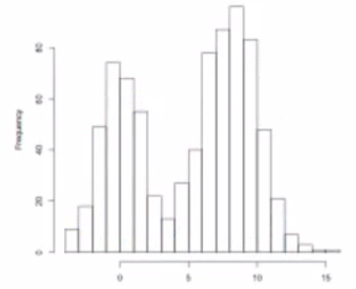
Peaks
Vary by the number of peaks and whether or not they have a peak

Slide 51
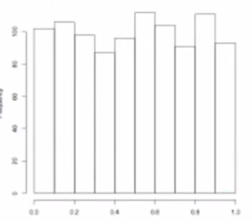
Symmetry
How symmetric they are and how long their tails are relative to each other.

Slide 52
Histogram of life expectancy for the 197 countries and territories for 2011

Slide 53
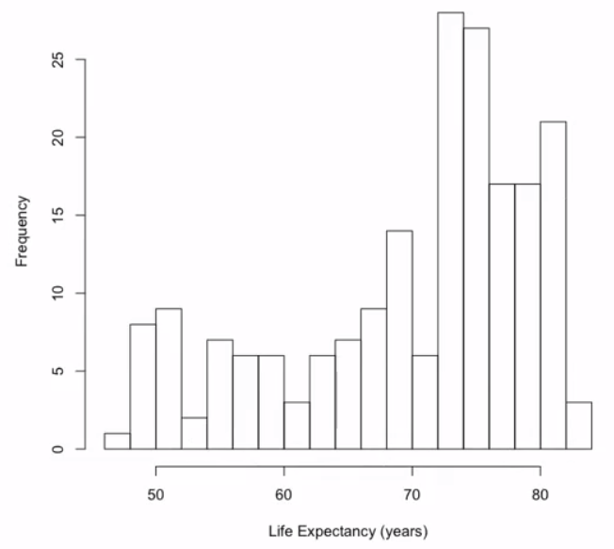
2 year histogram - More Noisy

Slide 54
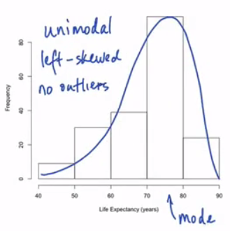
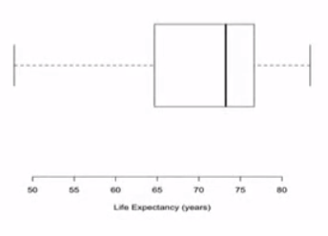
Histogram vs Box Plot
Notes:
Uni-modal, multi-modal
Left skewed, right skewed
Outliers – gaps between bins

Slide 55
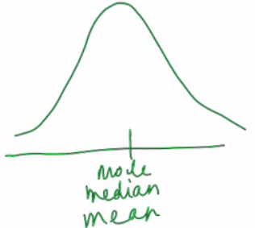
Symmetric
If the distribution is symmetric, the mean, median, and mode are all approximately the same.

Slide 56
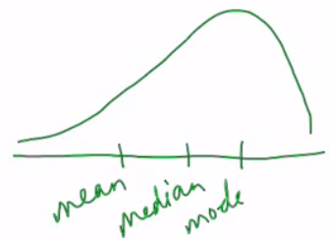
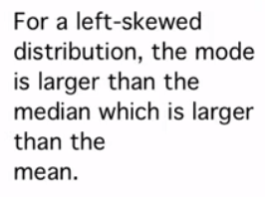
Left Skewed

Slide 57
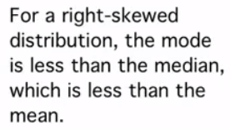
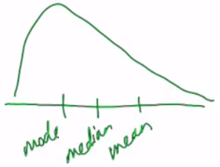
Right Skewed

Slide 58
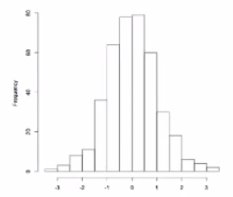
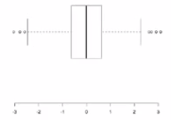
Symmetric Unimodal

Slide 59
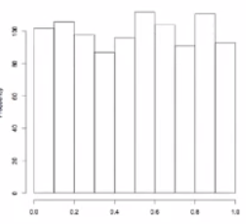
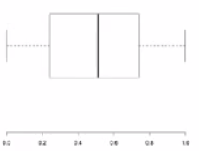
Symmetric Uniform

Slide 60
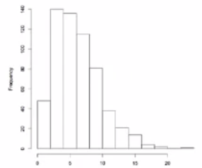
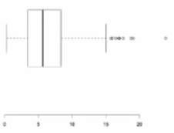
Right Skewed Unimodal

Slide 61
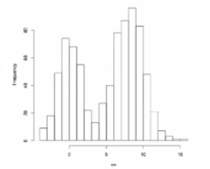
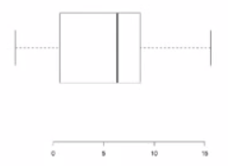
Bimodal
For the bimodal distribution, the box plot fails to capture the two peaks.
So, this is a situation where a histogram can be more useful than a box plot.

Slide 62
Unimodal and symmetric distributions of data with histograms that have roughly a bell shape are very common
For data with this shape, the standard deviation is an important measure of spread or variability.
The empirical rule tells us how the frequency of data values is related to the standard deviation.

Slide 63
Empirical rule
In particular, approximately 68% of the data values are within the range from the mean minus 1 standard deviation to the mean plus 1 standard deviation.
About 95% of data values are within the mean plus or minus 2 standard deviations.
And 99.7%, almost all of the data values are within three standard deviations of the mean.

Slide 64
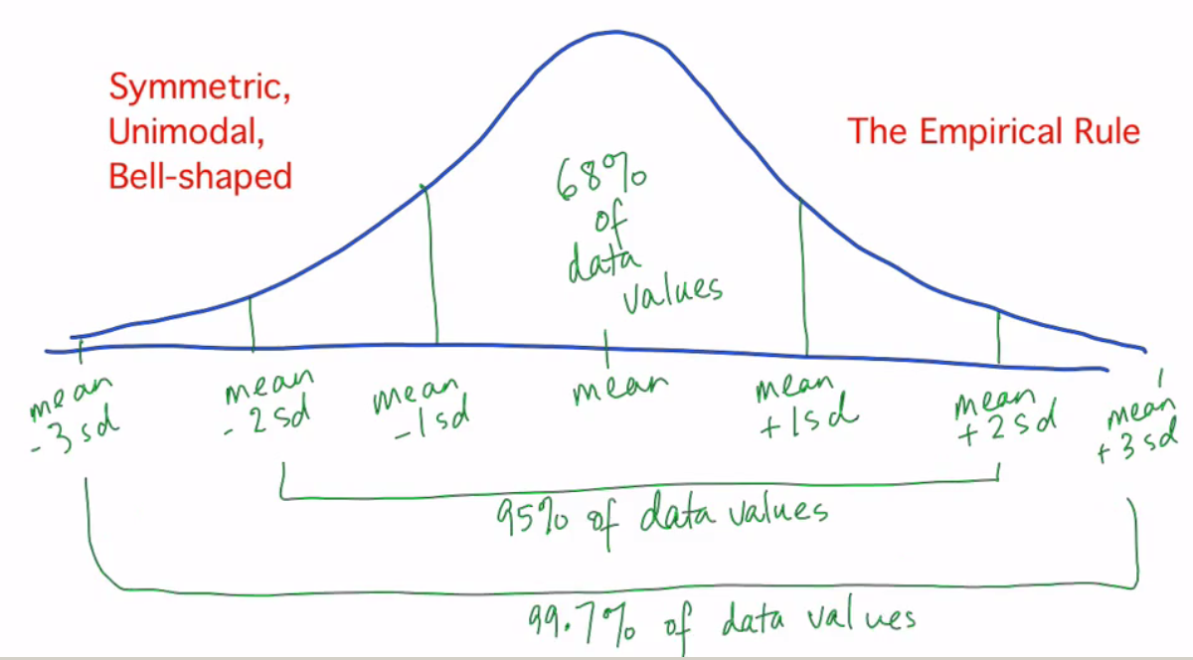
Empirical rule

Slide 65
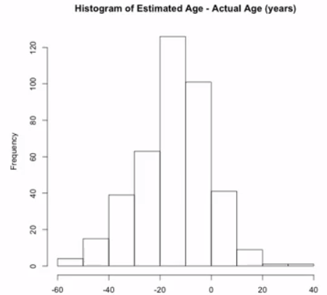
Estimated Age – Actual Age from 400 skeletons

Slide 66
Empirical Rule
The mean is - 14.2 and the standard deviation is 14.1.
1 standard deviation on either side of the mean, is the range from negative 28 to 0, which covers 273 of the 400 data values, or 68.3%.
Two standard deviations on either side of the mean is the range from negative 42 to 14, which covers 380 or 95% of the 400 data values.
And 3 standard deviations on either side of the mean is the range from negative 57 to 28, which covers 397 of the 400 data values or 99.3%.
We can see that this is very close to the 68, 95, 99.7% that we expected from the empirical rule.

Slide 67
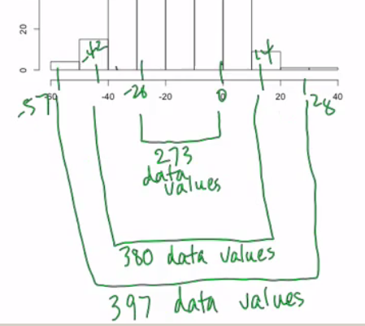

Slide 68
Empirical rule for Left Skewed histogram
It works for the life expectancy data, which is left-skewed.
The mean for these data is 69.9 and the standard deviation is 9.7.
It can be shown that 128 of the 197 countries and territories in our data, that 65% are within one standard deviation of the mean,
186, or 94.4% are within two standard deviations of the mean, and
197, all of the countries and territories, are within three standard deviations of the mean.
We can see that even for this left-skewed distribution, we are very close to the 68, 95,99.7% of the empirical rule.

Slide 70
Categorical Variables

Slide 71
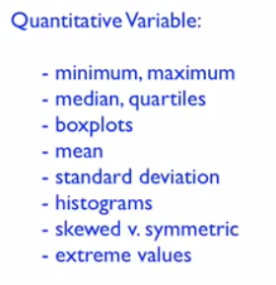
Quantitative Variables
Variables represented by numbers that can be larger and smaller and so on.

Slide 72
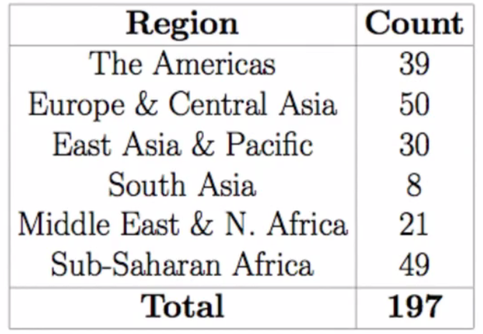
Categorical Variables
Categorical Variables are variables that are not represented by numbers
For example – Life Expectancy data – region wise

Slide 73

Bar Chart

Slide 74


Relative Frequencies

Slide 75

Pie Chart

Slide 76


Categorical Variables

Slide 77



Slide 78
R

Slide 79
Some features of data
Observational Unit (Unit of analysis) :
An observational unit is the person or thing on which measurements are taken
country or territory and in life expectancy data,
skeleton in anthropological data, and
soccer player in the data of salaries of New York Red Bulls players.

Slide 80
Some features of data
Variable: characteristic that we've measured on an observational unit.
In life expectancy data, this includes, life expectancy, as well as region of the world.
In anthropological data, variables include age at death, sex, BMI, the estimated age at death, the difference between the actual and estimated age at death, which is an example of a variable calculated from other variables, and
the salary of our soccer players.

Slide 81
Quantitative, Categorical and Ordinal Variables
An example of ordinal variable
BMI classifications
Since underweight is less than normal, which is less than overweight, which is less than obese.
Another example of an ordinal variable is the response to a Likert item on a questionnaire, where the respondent gets to choose from strongly disagree, disagree, and so on, up to strongly agree.

Slide 82
Error correction
Outliers shouldn't be ignored or routinely removed from the data.
It can happen that an outlier is a mistake.
In a dataset of ages, say, an age of 555 is clearly impossible and was likely a typo.
Cleaning data by correcting errors like this is an important first step in dealing with a new dataset.
It's important to try to find out the reason for unusual observations.
When outliers are not mistakes, they might be the most interesting feature, and removing them would remove an important aspect of the data.

Slide 83
Missing Values
Sometimes, the fact that a data value was missing tells us something about what it would have been, had it been observed.
Imagine a scale for measuring a person's weight that only goes up to, say, 100 kilograms.
Any larger subjects who were part of the study using this scale would have had a missing value for their weight.
Not including them in the analyses would bias the results by, for example, having a mean weight that was smaller than the actual mean weight would have been, had the larger subjects been included.

